Slide 1

Enhancing Sustainable Agriculture for Ensuring Food Security
To develop a website that addresses the issues faced by farmers in a given locality by facilitating communication between farmers, helping them farm efficiently and effectively, keeping track of the food market prices and suggesting crop rotations based of availability and sustainability in a given area.

Slide 2
Problems faced by Farmers
Lack of food security due to inadequate knowledge of market requirements at a given time.
Unsustainable agricultural practices due to lack of knowledge of practices like crop rotation and nutrient replenishment of the soil.
Inefficiency in seed selection and harvesting methods leading to unprofitable yield and infected crops.

Slide 3
Key Features of our Project
This website will help store the farmer's data in a single place for easy access.
A forum to access latest articles and posts by other farmers in the locality to keep track of the current market status.
A marketplace to help identify trends in commodities, their prices and availability to ensure food security by reducing crop wastage.
A helpline to contact government and private agencies in case of an agricultural emergency so find a quick and efficient remedy to a solution.

Slide 4
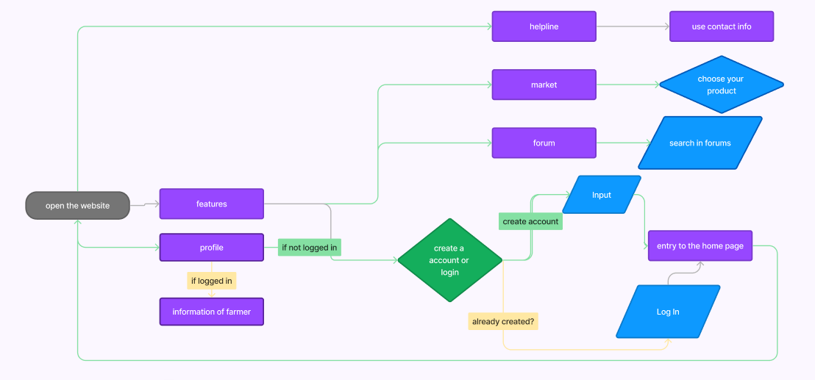
FLOW CHART OF OUR WEBSITE

Slide 5

UNSUPERVISED ML- BASED RECOMMENDATION SYSTEM

Slide 6

For enhancing farmers' awareness of emerging crops, innovative tools, and looming challenges in their local agricultural landscapes.
Our website aims to empower farmers by providing comprehensive information and timely warnings about potential obstacles they may encounter based on agriculture on their farming journey.
We plan to incorporate state-of-the-art machine learning techniques, specifically leveraging unsupervised clustering algorithms, to provide farmers with tailored recommendations and insights.

Slide 7
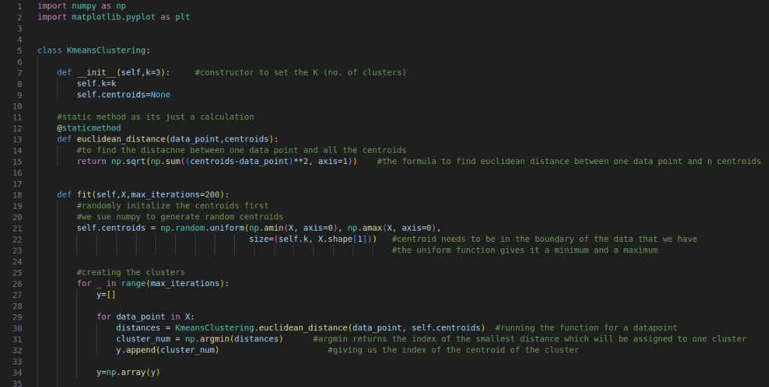
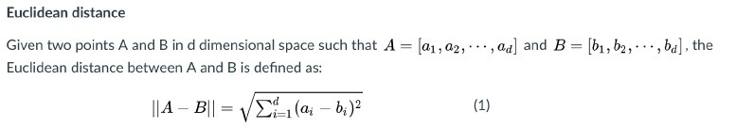
K-means Clustering Model: A simple clustering method that forms k clusters by iteratively reassigning
samples to the closest centroids and after that moves the centroids to the center
of the new formed clusters.

Slide 8
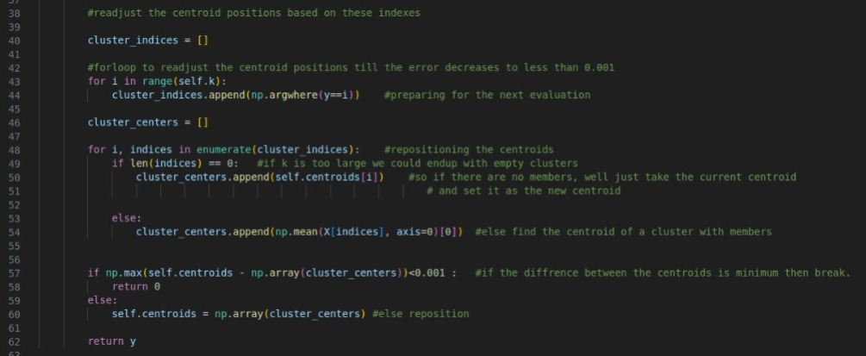
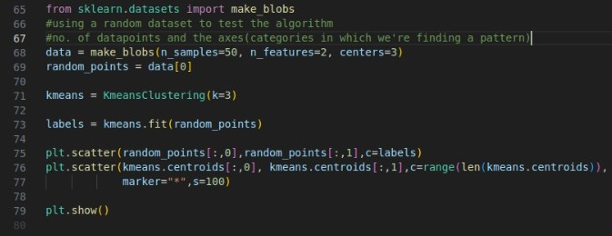
The Main Algorithm
Sample Dataset
Implemented Using
Sci-kit Learn Library

Slide 9
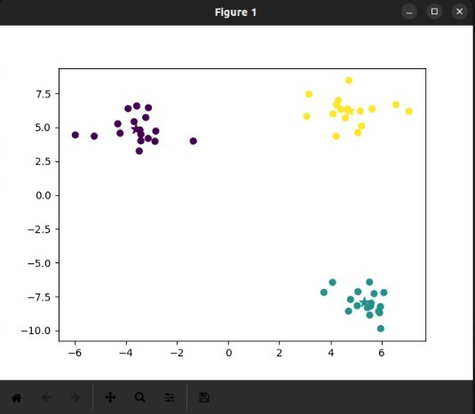
Generated Scatter Plot
By relating the dataset provided through the website to the 'random_points' in the model, we can find a pattern to relate the locality provided to us to the relevant articles based on agriculture in the area.
We then plan to display the articles and their corresponding links on the "Forums" section on the website.

Slide 10

Integrating API with the website
To help the farmers find the prices of their commodities at a particular time, we are integrating an API with the website which has the functionality to show the minimum and maximum market value of the given product.
The API we are using is Agmarket which is run by the Ministry of Agriculture and Farmer's Welfare under the Government of India

Slide 11
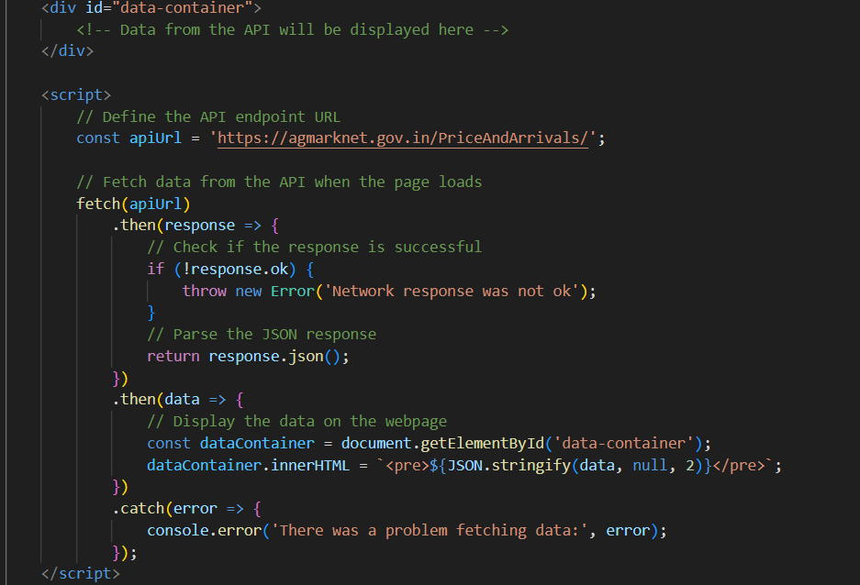

Slide 12
We have an empty <div> with the id data-container where we will display the data fetched from the API.
We use JavaScript to fetch data from the API using the fetch function.
We use .then() to handle the response from the API. Here, we assume the API returns JSON data, so we parse it using .json().
Once we have the parsed data, we update the content of the data-container with the fetched data.
Using this approach we can integrate this API to further increase functionality of the website by showing market prices and helping farmers sell their commodities at fair values so as not to get duped by third parties quoting low prices for their personal gain which leads to unsustainable food security by threatening the livelihood of the farmers

Slide 13

Thank you!
Joel Josy
Khuushi Maheshwari
Pranjali Singh
Manas Waykole
Sohan Shinde
Trojan Knights
HackNXS'24

